Slide 1

Big Data Infrastructure
Session 1: Introduction
Jimmy Lin
University of Maryland
Monday, January 26, 2015
This work is licensed under a Creative Commons Attribution-Noncommercial-Share Alike 3.0 United States See http://creativecommons.org/licenses/by-nc-sa/3.0/us/ for details

Slide 2
What is this course about?
What is big data?
Why big data?
Infrastructure for big data

Slide 3

From the Ivory Tower…
Source: Wikipedia (All Souls College, Oxford)

Slide 4
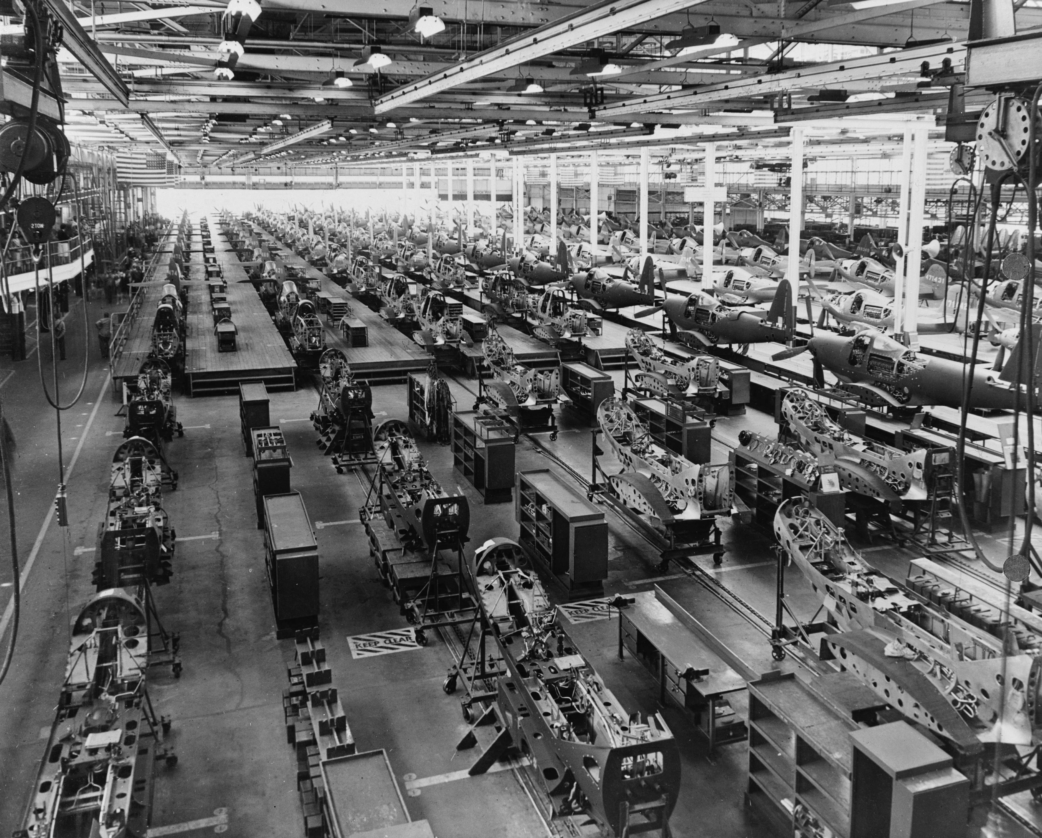

… to building sh*t that works
Source: Wikipedia (Factory)

Slide 5
… and back.
Source: Wikipedia (All Souls College, Oxford)

Slide 6
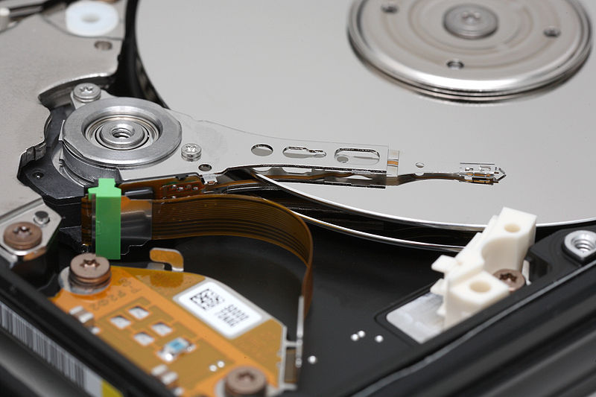
Big Data
Source: Wikipedia (Hard disk drive)

Slide 7








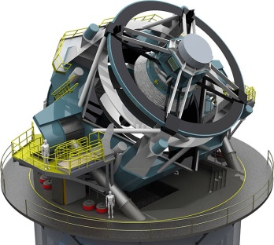
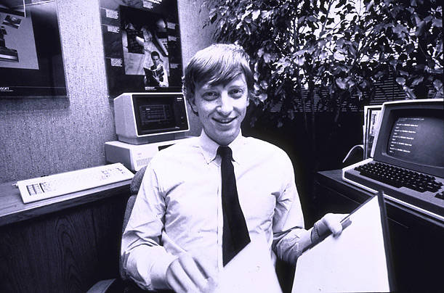

How much data?
Processes 20 PB a day (2008)
Crawls 20B web pages a day (2012)
Search index is 100+ PB (5/2014)
Bigtable serves 2+ EB, 600M QPS (5/2014)
400B pages, 10+ PB (2/2014)
Hadoop: 365 PB, 330K nodes (6/2014)
Hadoop: 10K nodes, 150K cores, 150 PB (4/2014)
150 PB on 50k+ servers running 15k apps (6/2011)
300 PB data in Hive + 600 TB/day (4/2014)
LHC: ~15 PB a year
S3: 2T objects, 1.1M request/second (4/2013)
640K ought to be enough for anybody.
LSST: 6-10 PB a year (~2020)
SKA: 0.3 – 1.5 EB per year (~2020)

Slide 8
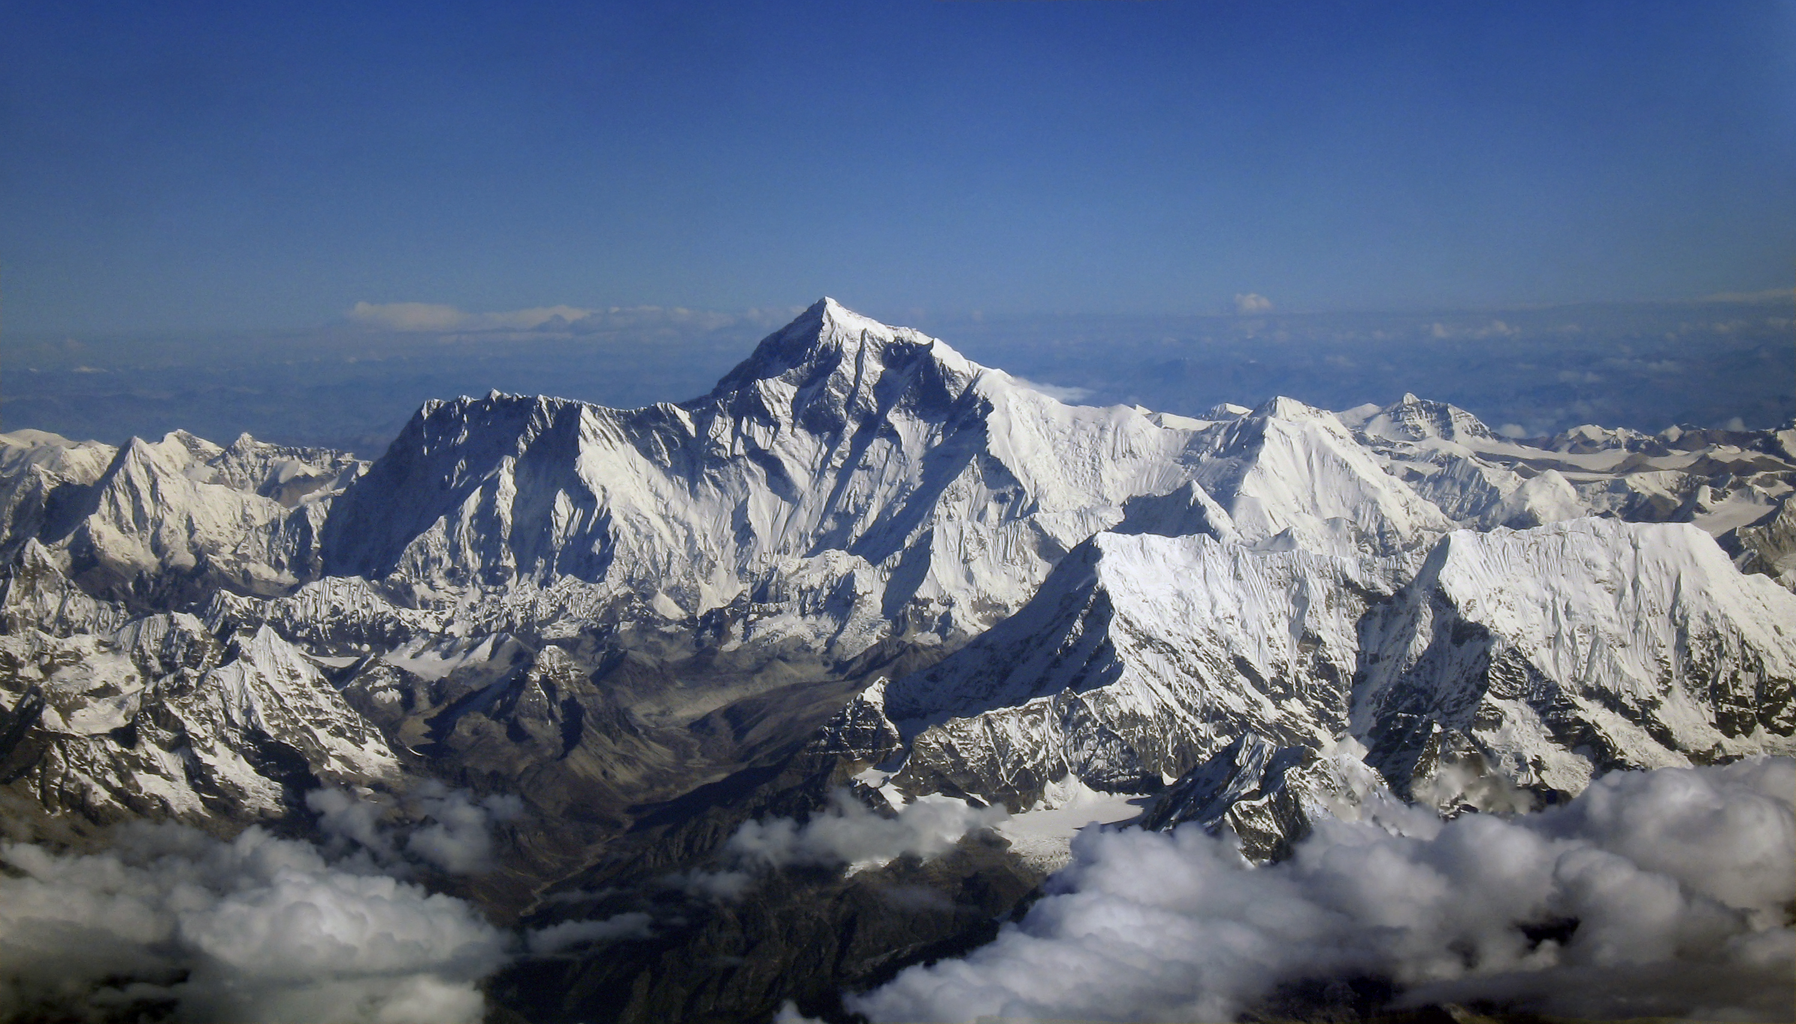
Why big data?
Science
Engineering
Commerce
Source: Wikipedia (Everest)

Slide 9
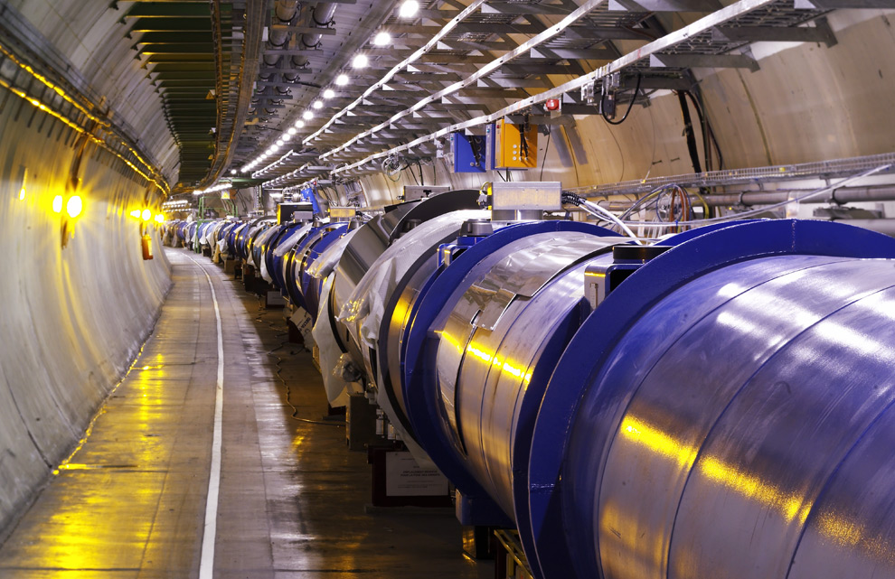
Science
Emergence of the 4th Paradigm
Data-intensive e-Science
Maximilien Brice, © CERN
Notes:
By the time it shuts down in 2011, the CERN collider should have amassed about 20 times as much data as it now has. (NYTimes article, “Trillions of Reasons to Be Excited”, 11/1/2010)

Slide 10
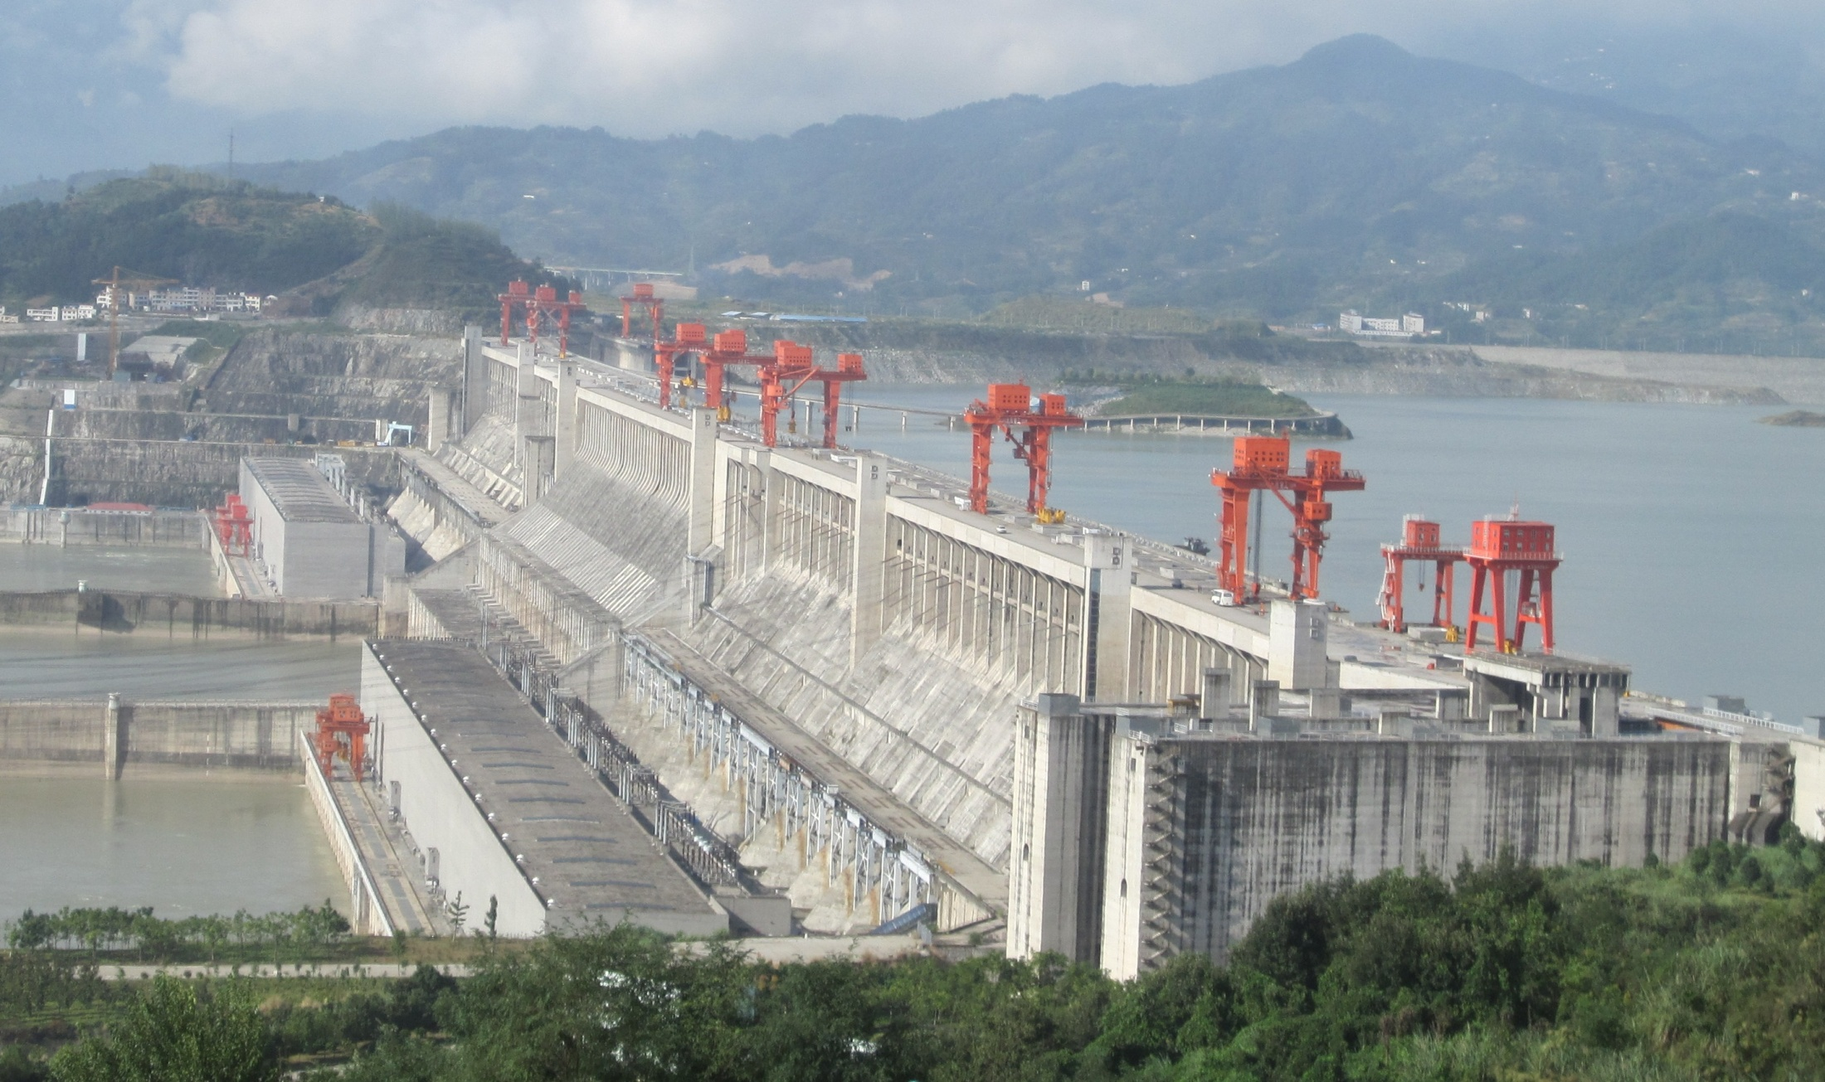
Engineering
The unreasonable effectiveness of data
Count and normalize!
Source: Wikipedia (Three Gorges Dam)

Slide 11

Know thy customers
Data → Insights → Competitive advantages
Commerce
Source: Wikiedia (Shinjuku, Tokyo)

Slide 12

Why big data?
Infrastructure for big data
Source: Wikipedia (Noctilucent cloud)

Slide 13

Course Administrivia
Source: http://www.flickr.com/photos/artmind_etcetera/6336693594/

Slide 14
My Expectations
You’re already a good Java programmer
This course does not teach programming
You’re expected to pick up Hadoop with minimal help
You’re good at debugging
Your own code
Compiling, patching, and installing open source software
You have basic knowledge of:
Probability and statistics, discrete math
Computer architecture

Slide 15
How will I actually learn Hadoop?
Hadoop: The Definitive Guide
RTFM
RTFC(!)

Slide 16
This course is not for you…
If you’re not genuinely interested in the topic
If you can’t put in the time
If you’re uncomfortable with the uncertainty, unpredictability, etc. that comes with immature software
Otherwise, this will be a rewarding and fun course!

Slide 17
Details, Details…
Make sure you’re on the mailing list!
Textbooks
Components of the final grade:
Assignments
Final exam
Final project
I am unlikely to accept the following excuses:
“Too busy”
“It took longer than I thought it would take”
“It was harder than I initially thought”
“My dog ate my homework” and modern variants thereof

Slide 18
Hadoop Resources
Hadoop on your local machine
Hadoop in a virtual machine on your local machine
Hadoop on a UMIACS cluster

Slide 19

Be Prepared…
Source: Wikipedia (The Scream)

Slide 20
“Hadoop Zen”
Parts of the ecosystem are still immature
We’ve come a long way since 2007, but still far to go…
Bugs, undocumented “features”, inexplicable behavior, etc.
Don’t get frustrated (take a deep breath)…
Those W$*#T@F! moments
Be patient…
We will inevitably encounter “situations” along the way
Be flexible…
We will have to be creative in workarounds
Be constructive…
Tell me how I can make everyone’s experience better

Slide 21

“Hadoop Zen”
Source: Wikipedia (Japanese rock garden)

Slide 22

Interlude: Cloud Computing
Source: Wikipedia (Clouds)

Slide 23
The best thing since sliced bread?
Before clouds…
Grids
Connection machine
Vector supercomputers
…
Cloud computing means many different things:
Big data
Rebranding of web 2.0
Utility computing
Everything as a service

Slide 24
Rebranding of web 2.0
Rich, interactive web applications
Clouds refer to the servers that run them
AJAX as the de facto standard (for better or worse)
Examples: Facebook, YouTube, Gmail, …
“The network is the computer”: take two
User data is stored “in the clouds”
Rise of the netbook, smartphones, etc.
Browser is the OS

Slide 25
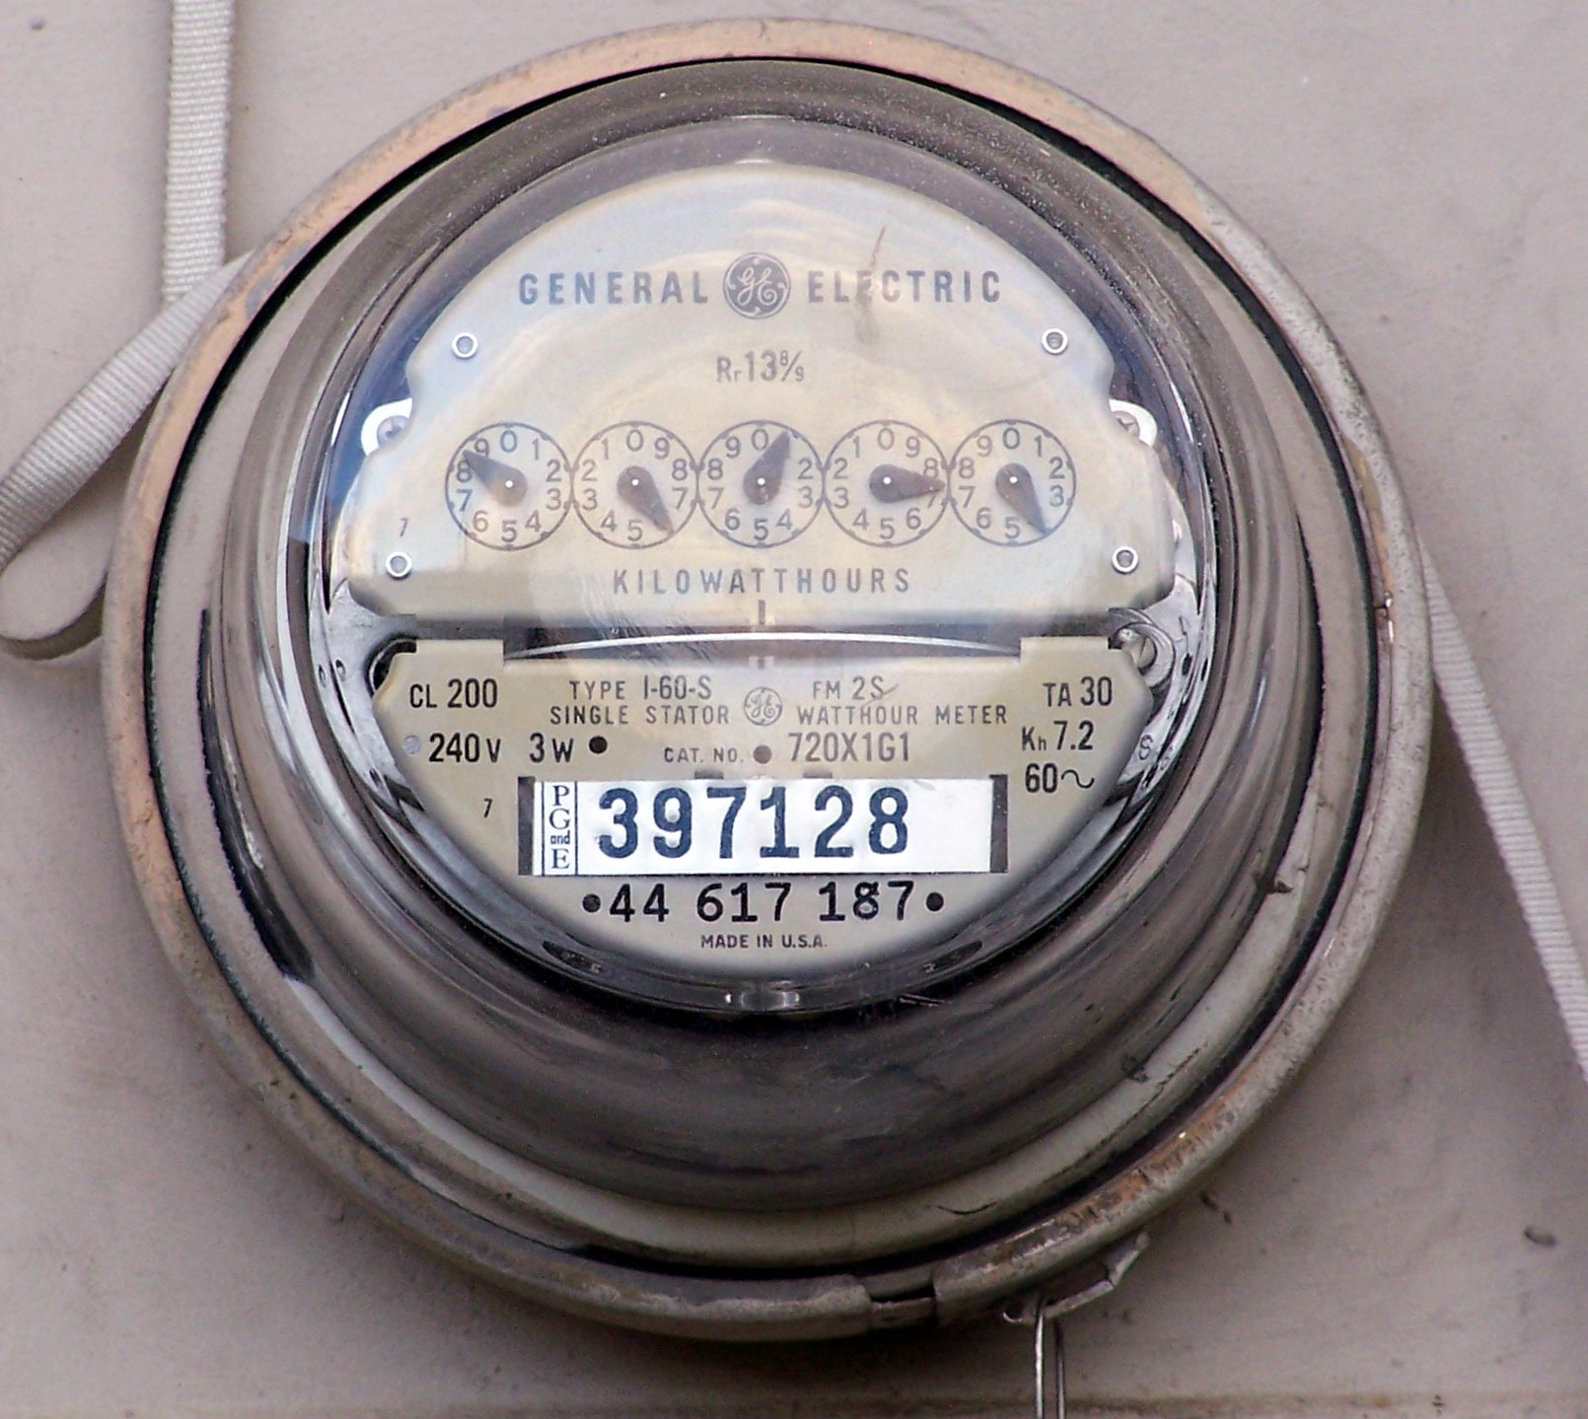
Source: Wikipedia (Electricity meter)

Slide 26
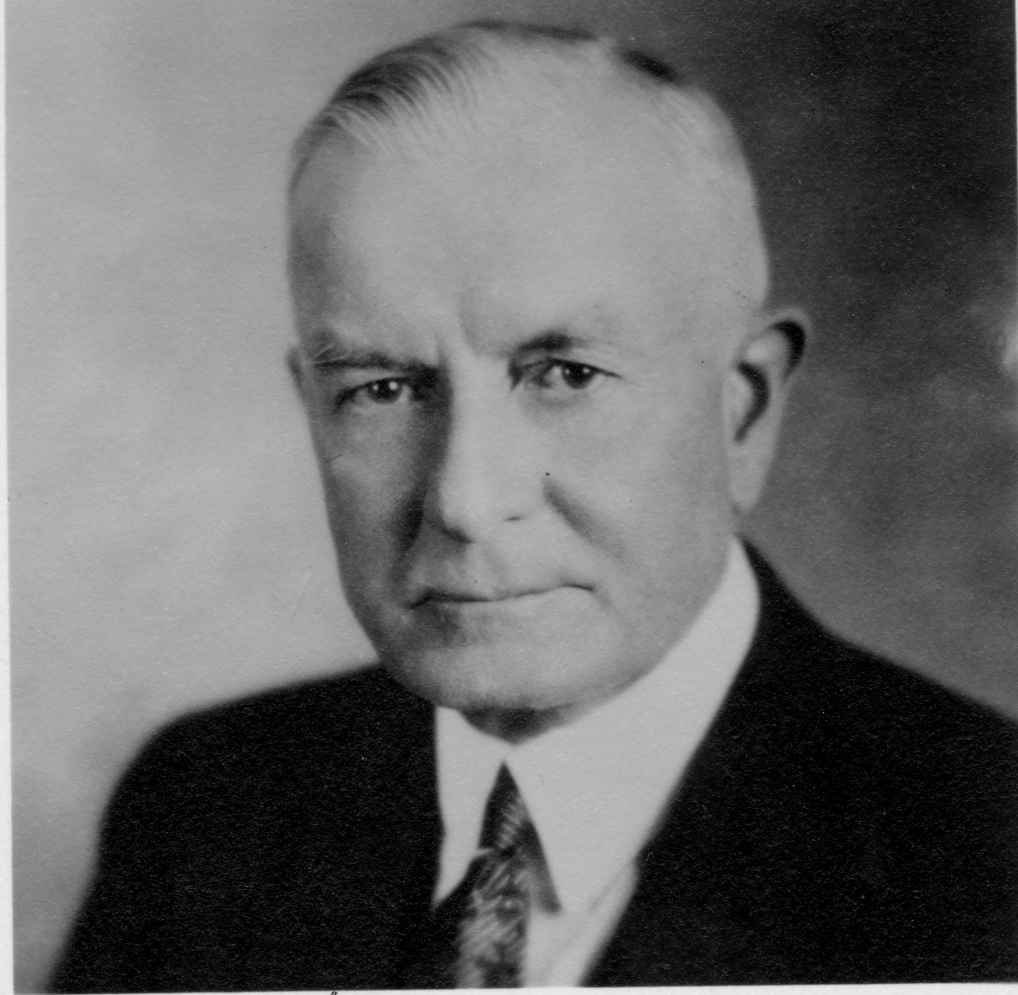
Utility Computing
What?
Computing resources as a metered service (“pay as you go”)
Ability to dynamically provision virtual machines
Why?
Cost: capital vs. operating expenses
Scalability: “infinite” capacity
Elasticity: scale up or down on demand
Does it make sense?
Benefits to cloud users
Business case for cloud providers
I think there is a world market for about five computers.

Slide 27
Enabling Technology: Virtualization
App
App
App
App
App
App
OS
OS
OS
Operating System
Hypervisor
Hardware
Hardware
Traditional Stack
Virtualized Stack

Slide 28
Everything as a Service
Utility computing = Infrastructure as a Service (IaaS)
Why buy machines when you can rent cycles?
Examples: Amazon’s EC2, Rackspace
Platform as a Service (PaaS)
Give me nice API and take care of the maintenance, upgrades, …
Example: Google App Engine
Software as a Service (SaaS)
Just run it for me!
Example: Gmail, Salesforce

Slide 29
Who cares?
A source of problems…
Cloud-based services generate big data
Clouds make it easier to start companies that generate big data
As well as a solution…
Ability to provision analytics clusters on-demand in the cloud
Commoditization and democratization of big data capabilities

Slide 30
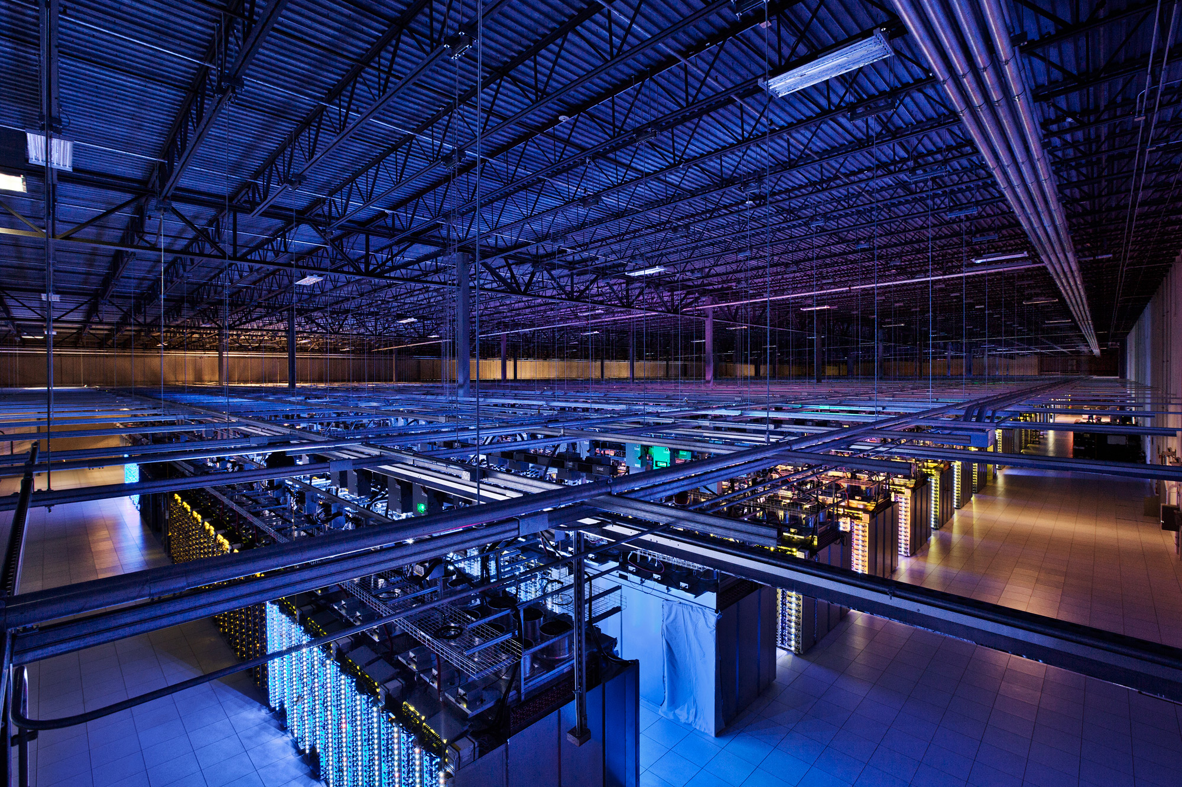
Tackling Big Data
Source: Google

Slide 31
Divide and Conquer
“Work”
Partition
w₁
w₂
w₃
worker
worker
worker
r₁
r₂
r₃
Combine
“Result”

Slide 32
Parallelization Challenges
How do we assign work units to workers?
What if we have more work units than workers?
What if workers need to share partial results?
How do we aggregate partial results?
How do we know all the workers have finished?
What if workers die?
What’s the common theme of all of these problems?

Slide 33
Common Theme?
Parallelization problems arise from:
Communication between workers (e.g., to exchange state)
Access to shared resources (e.g., data)
Thus, we need a synchronization mechanism

Slide 34
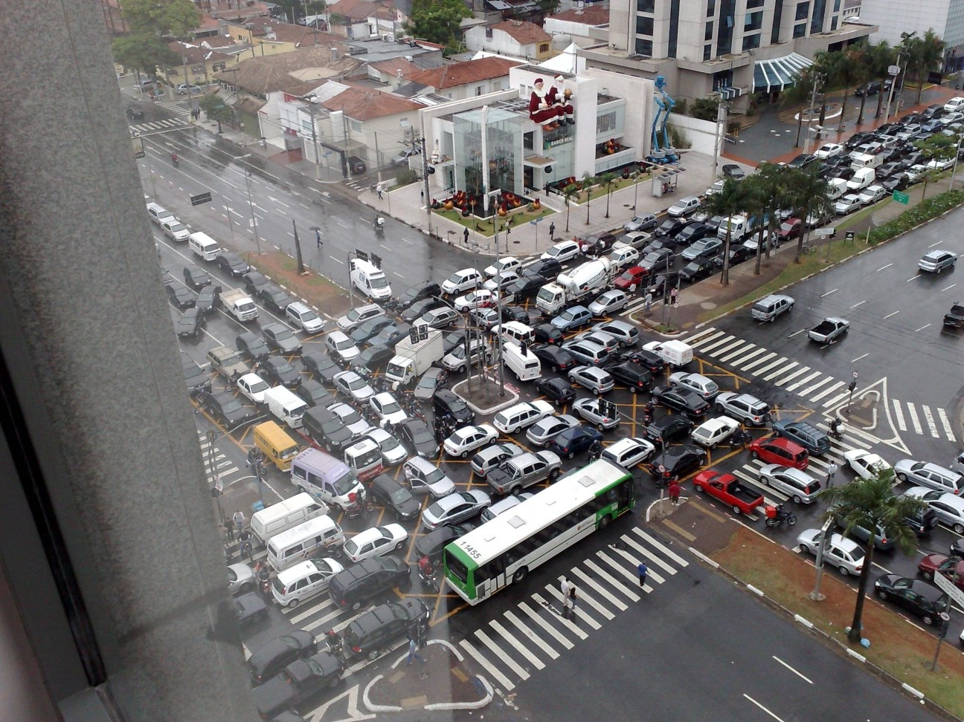
Source: Ricardo Guimarães Herrmann

Slide 35
Managing Multiple Workers
Difficult because
We don’t know the order in which workers run
We don’t know when workers interrupt each other
We don’t know when workers need to communicate partial results
We don’t know the order in which workers access shared data
Thus, we need:
Semaphores (lock, unlock)
Conditional variables (wait, notify, broadcast)
Barriers
Still, lots of problems:
Deadlock, livelock, race conditions...
Dining philosophers, sleeping barbers, cigarette smokers...
Moral of the story: be careful!

Slide 36
Current Tools
Shared Memory
Message Passing
Programming models
Shared memory (pthreads)
Message passing (MPI)
Design Patterns
Master-slaves
Producer-consumer flows
Shared work queues
Memory
P₁
P₂
P₃
P₄
P₅
P₁
P₂
P₃
P₄
P₅
producer
consumer
master
work queue
slaves
producer
consumer

Slide 37
Where the rubber meets the road
Concurrency is difficult to reason about
Concurrency is even more difficult to reason about
At the scale of datacenters and across datacenters
In the presence of failures
In terms of multiple interacting services
Not to mention debugging…
The reality:
Lots of one-off solutions, custom code
Write you own dedicated library, then program with it
Burden on the programmer to explicitly manage everything

Slide 38

Source: Wikipedia (Flat Tire)

Slide 39
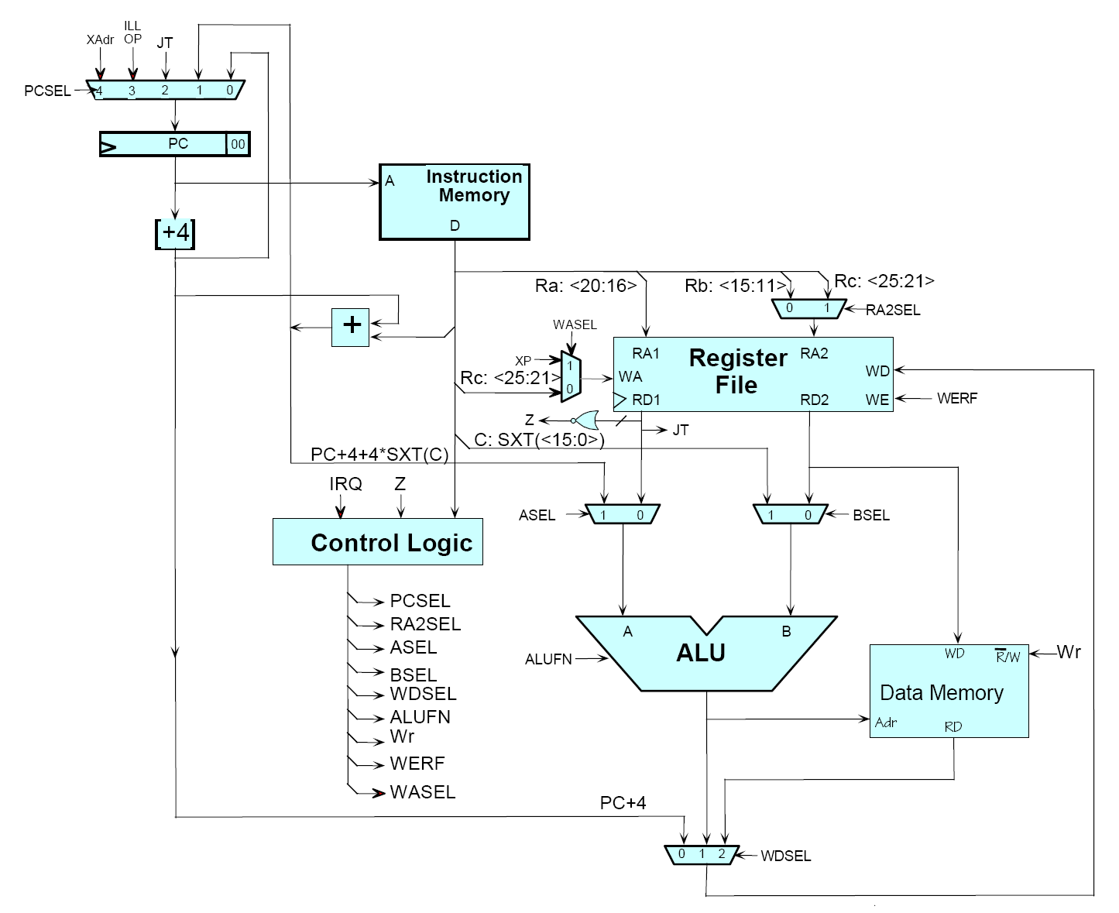
Source: MIT Open Courseware

Slide 40

Source: MIT Open Courseware

Slide 41
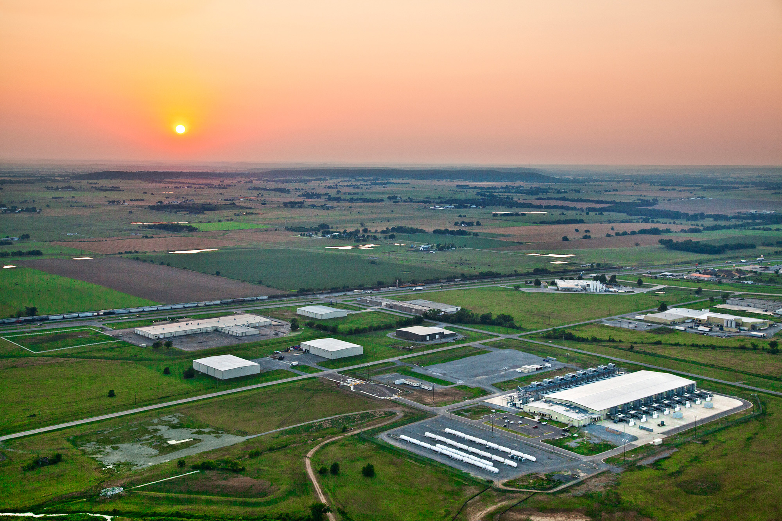
The datacenter is the computer!
Source: Google

Slide 42
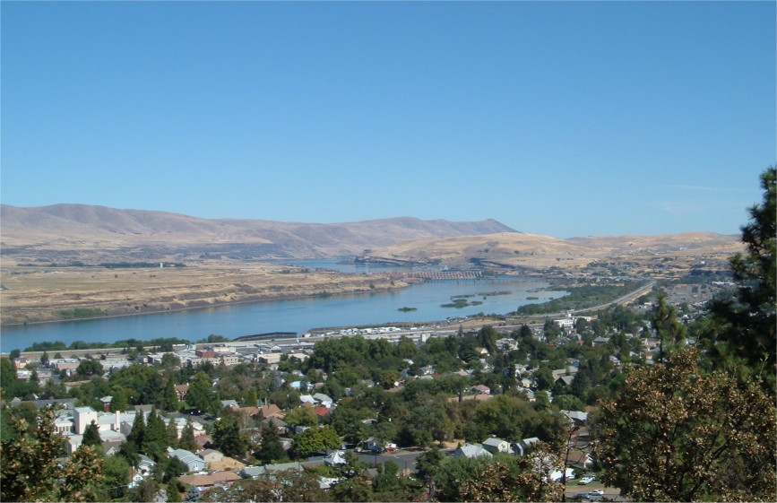
Source: Wikipedia (The Dalles, Oregon)

Slide 43
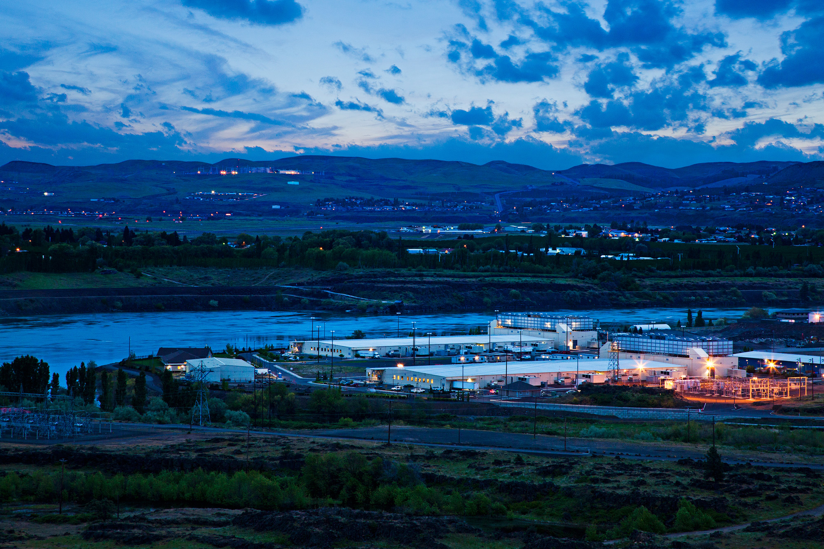
Source: Google

Slide 44
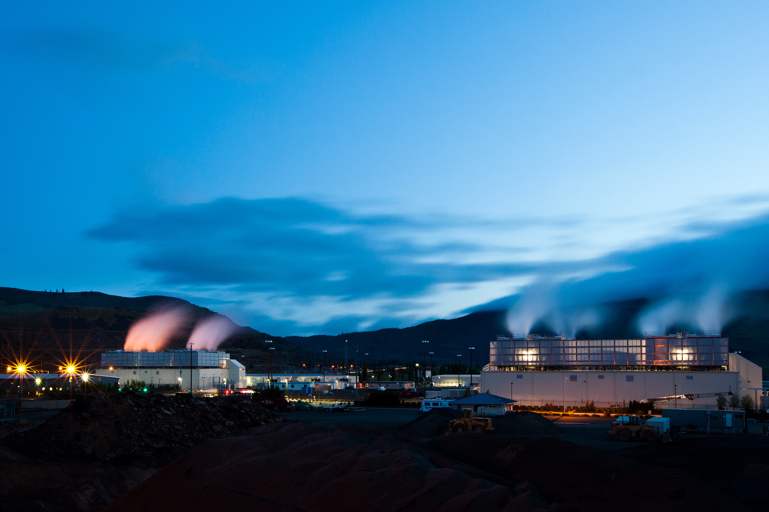
Source: Google

Slide 45
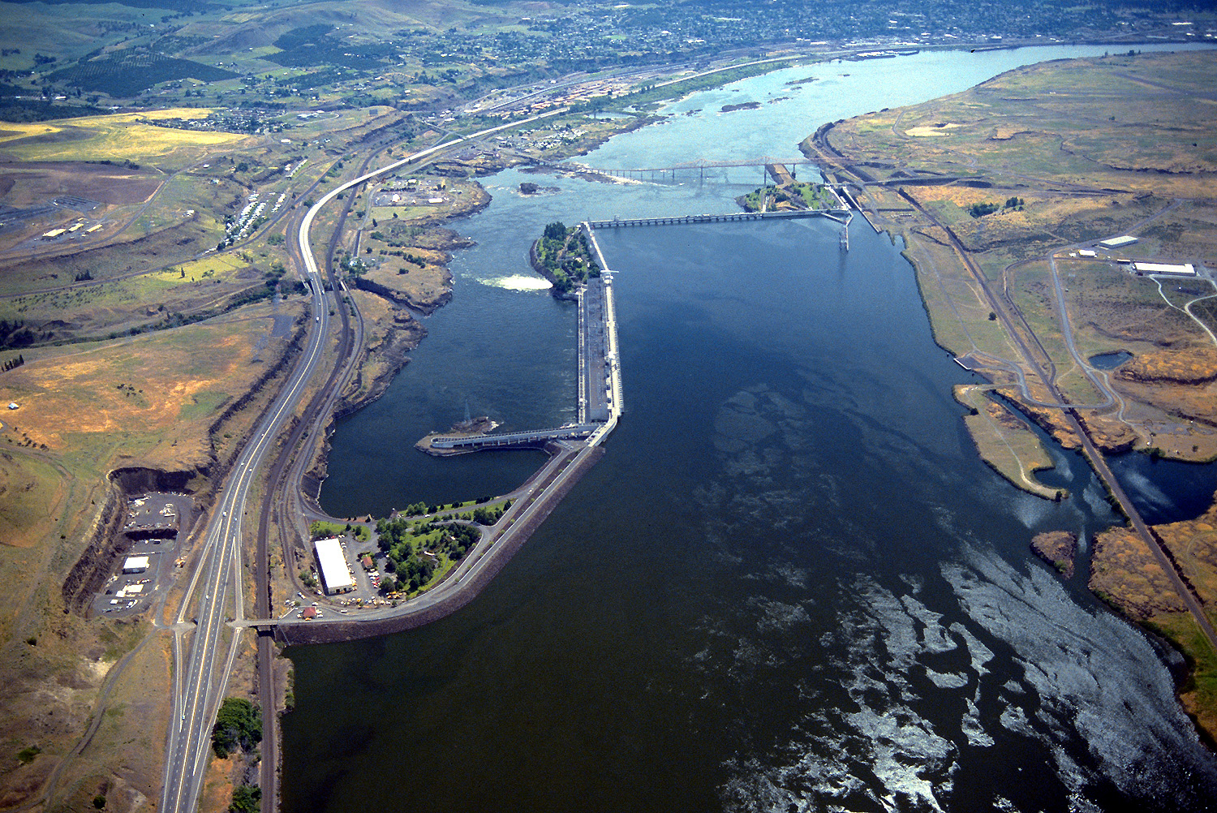
Source: Bonneville Power Administration

Slide 46
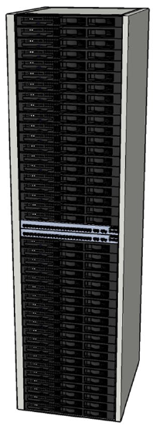
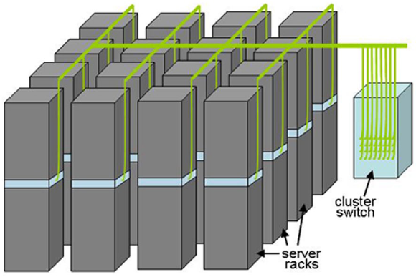

Building Blocks
Source: Barroso and Urs Hölzle (2009)

Slide 47
Source: Google

Slide 48
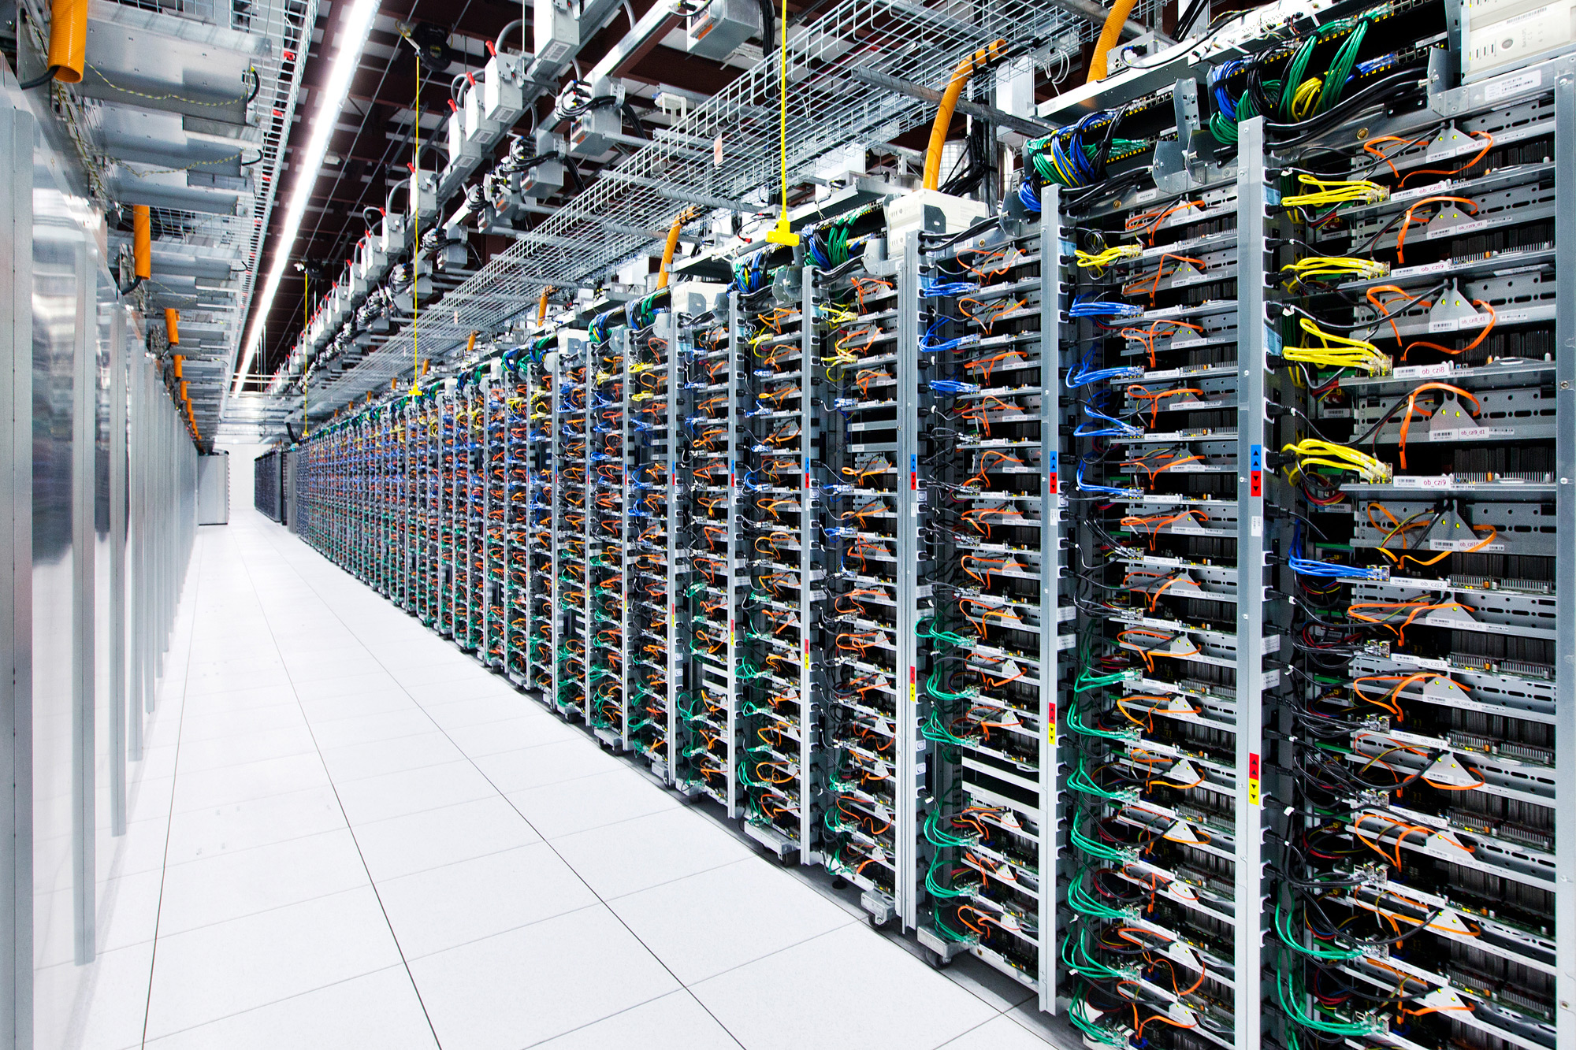
Source: Google

Slide 49
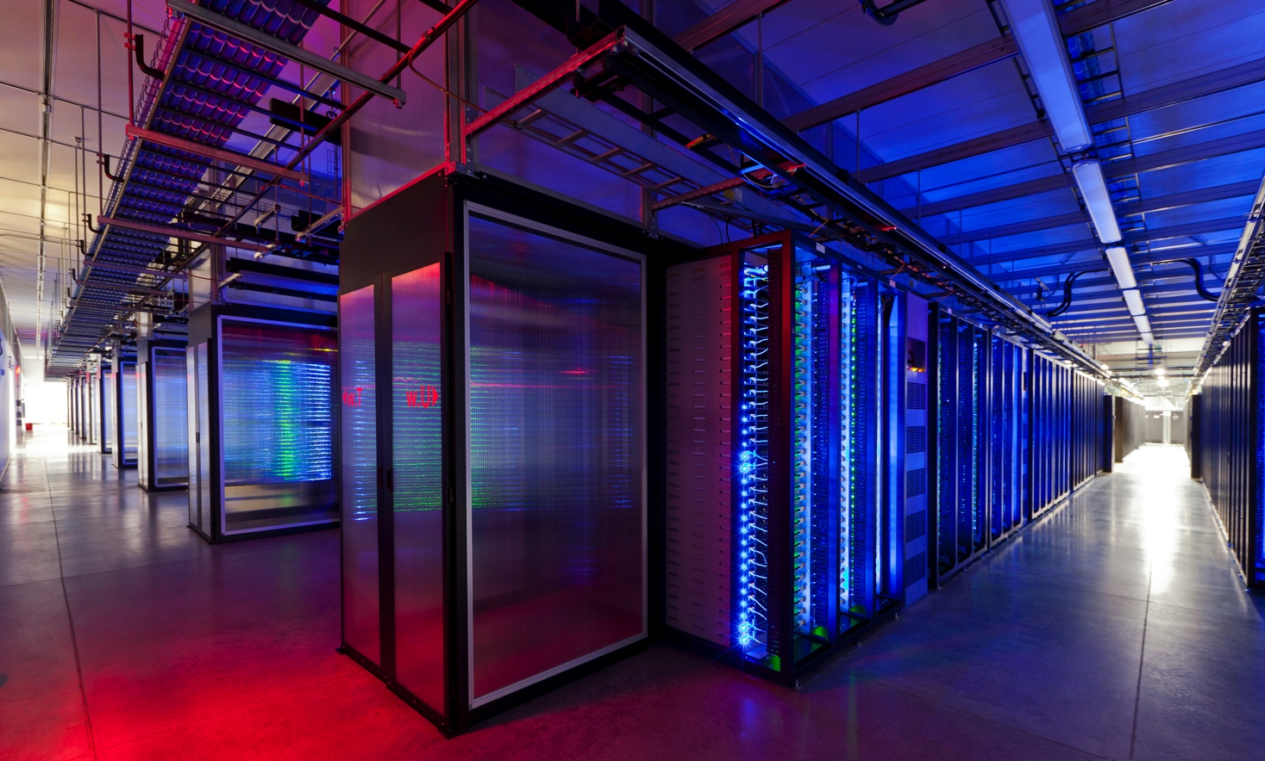
Source: Facebook

Slide 50
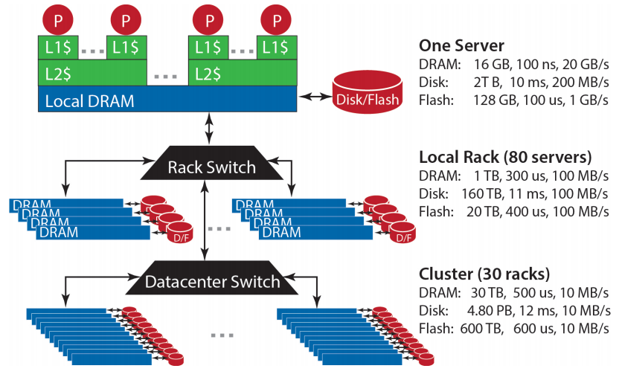
Storage Hierarchy
Source: Barroso and Urs Hölzle (2013)

Slide 51
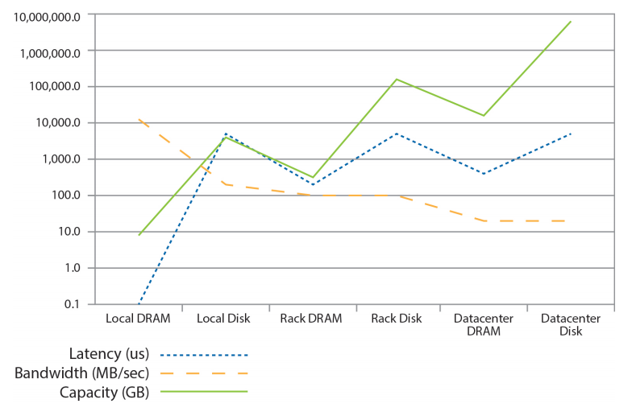
Storage Hierarchy
Source: Barroso and Urs Hölzle (2013)

Slide 52
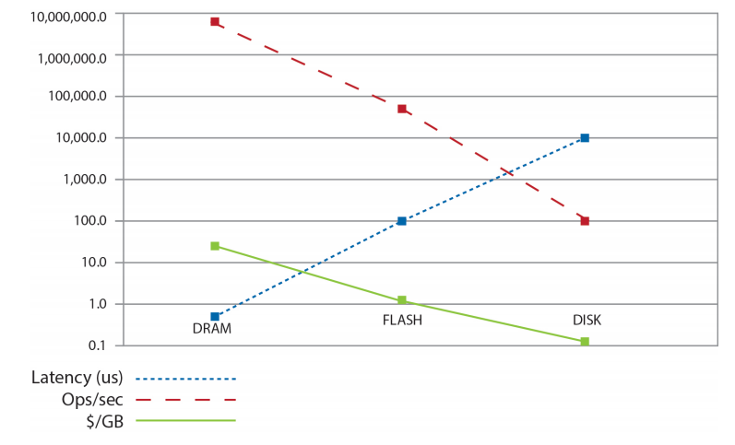
Storage Hierarchy
Source: Barroso and Urs Hölzle (2013)

Slide 53
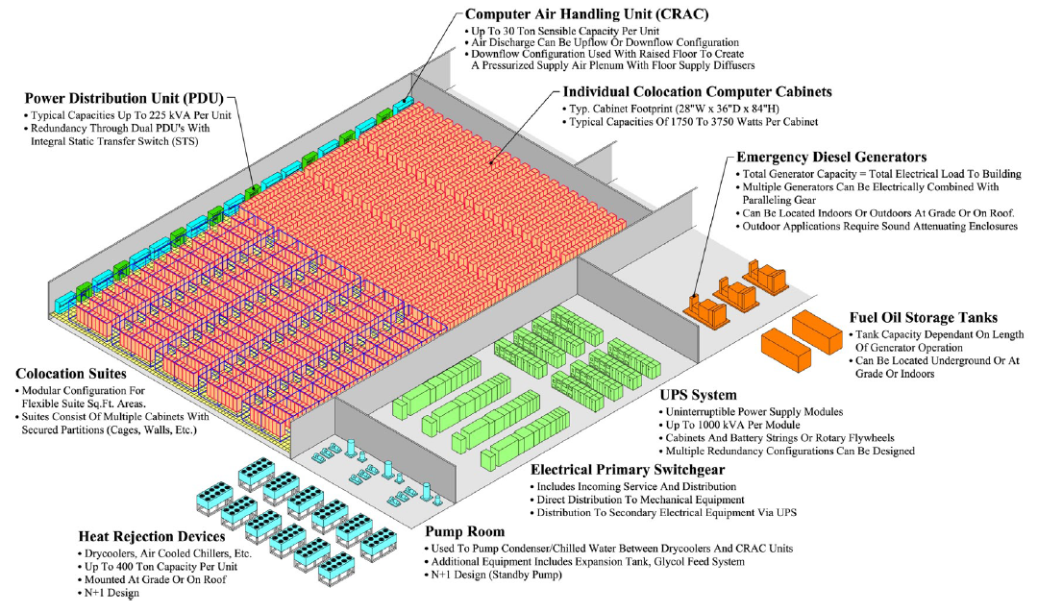
Anatomy of a Datacenter
Source: Barroso and Urs Hölzle (2013)

Slide 54
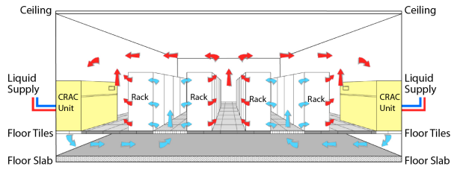
Anatomy of a Datacenter
Source: Barroso and Urs Hölzle (2013)

Slide 55
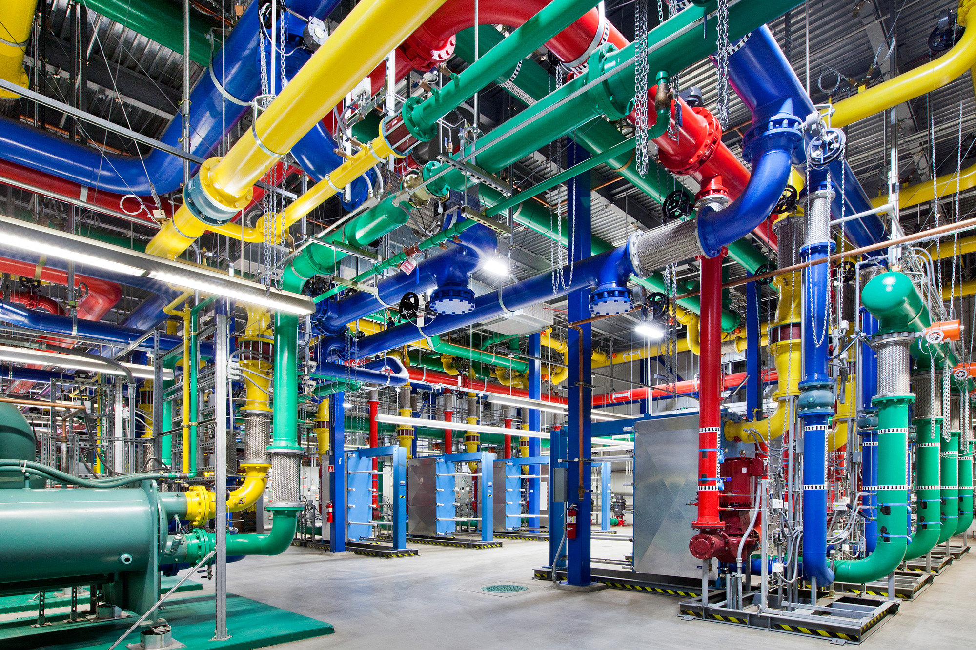
Source: Google

Slide 56
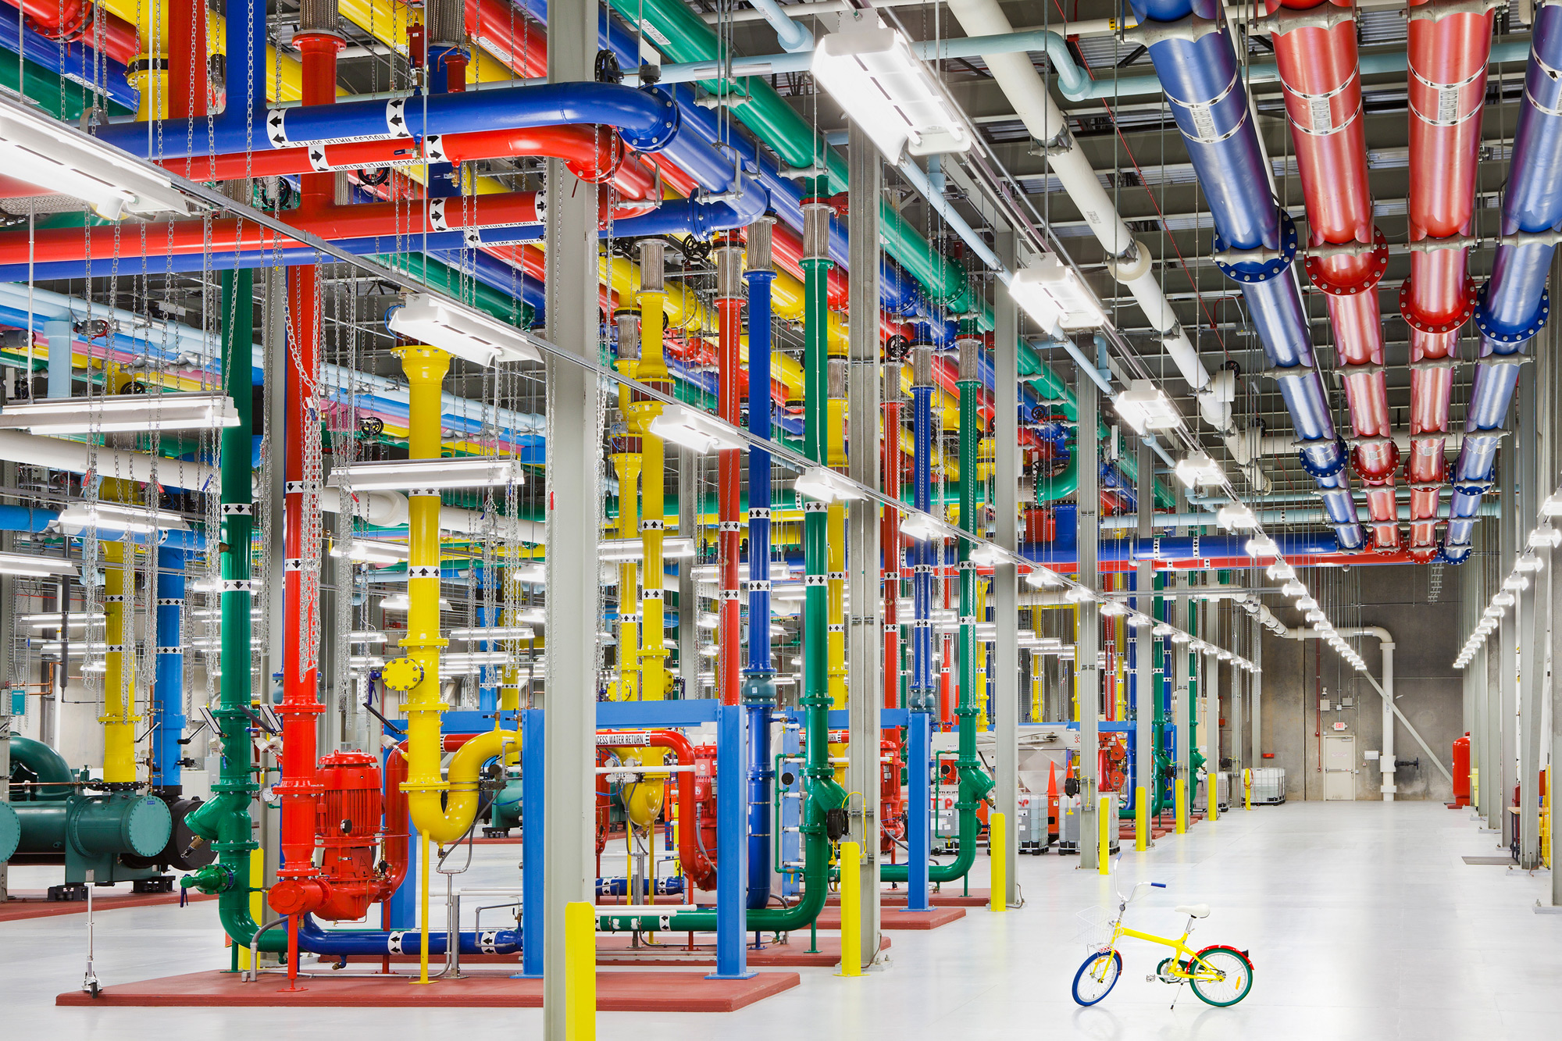
Source: Google

Slide 57
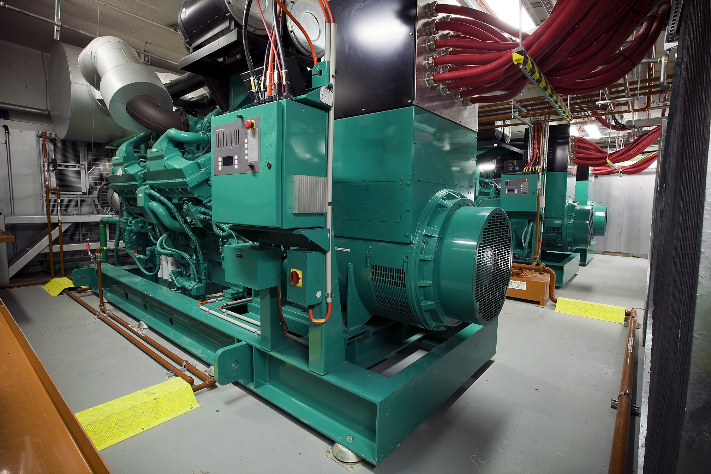
Source: CumminsPower

Slide 58
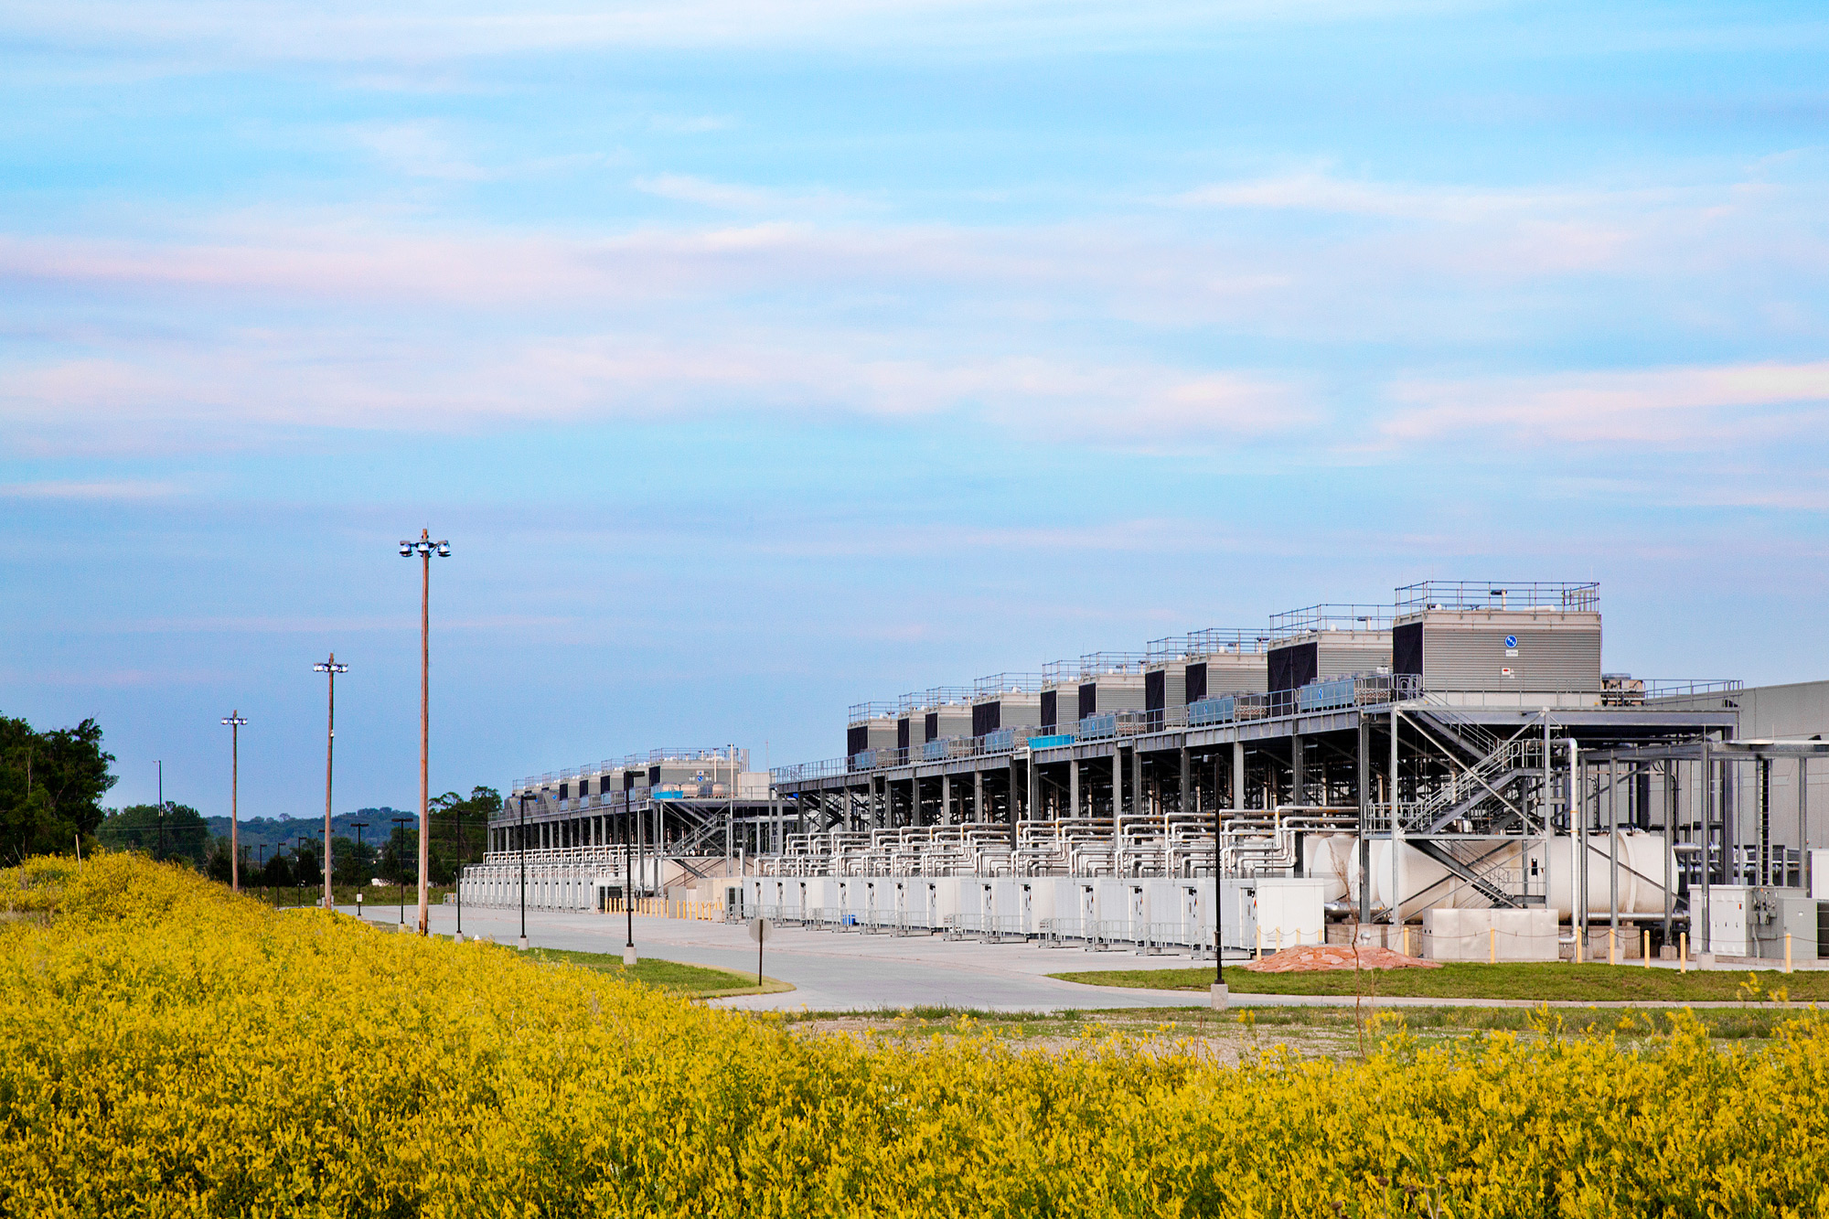
Source: Google

Slide 59
Aside: How much is 30 MW?
Source: Google

Slide 60
The datacenter is the computer
It’s all about the right level of abstraction
Moving beyond the von Neumann architecture
What’s the “instruction set” of the datacenter computer?
Hide system-level details from the developers
No more race conditions, lock contention, etc.
No need to explicitly worry about reliability, fault tolerance, etc.
Separating the what from the how
Developer specifies the computation that needs to be performed
Execution framework (“runtime”) handles actual execution

Slide 61
“Big Ideas”
Scale “out”, not “up”
Limits of SMP and large shared-memory machines
Move processing to the data
Cluster have limited bandwidth
Process data sequentially, avoid random access
Seeks are expensive, disk throughput is reasonable
Seamless scalability
From the mythical man-month to the tradable machine-hour

Slide 62
Scaling “up” vs. “out”
No single machine is large enough
Smaller cluster of large SMP machines vs. larger cluster of commodity machines (e.g., 16 128-core machines vs. 128 16-core machines)
Nodes need to talk to each other!
Intra-node latencies: ~100 ns
Inter-node latencies: ~100 μs
Let’s model communication overhead…
Source: analysis on this an subsequent slides from Barroso and Urs Hölzle (2009)

Slide 63
Modeling Communication Costs
Simple execution cost model:
Total cost = cost of computation + cost to access global data
Fraction of local access inversely proportional to size of cluster
n nodes (ignore cores for now)
Light communication: f =1
Medium communication: f =10
Heavy communication: f =100
What are the costs in parallelization?
1 ms + f × [100 ns × (1/n) + 100 μs × (1 - 1/n)]

Slide 64
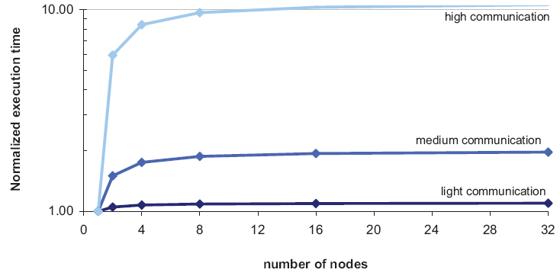
Cost of Parallelization

Slide 65
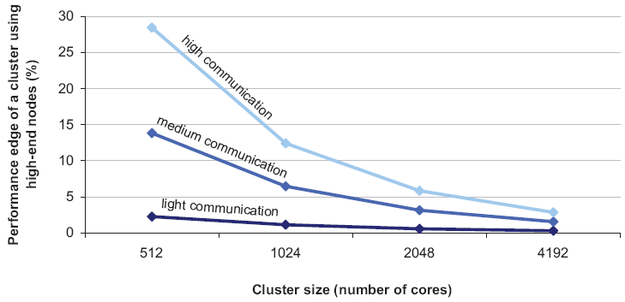
Advantages of scaling “up”
So why not?
Why does commodity beat exotic?

Slide 66
Moving Data Around
Source: Barroso and Urs Hölzle (2013)

Slide 67
Seeks vs. Scans
Consider a 1 TB database with 100 byte records
We want to update 1 percent of the records
Scenario 1: random access
Each update takes ~30 ms (seek, read, write)
10⁸ updates = ~35 days
Scenario 2: rewrite all records
Assume 100 MB/s throughput
Time = 5.6 hours(!)
Lesson: avoid random seeks!
Source: Ted Dunning, on Hadoop mailing list

Slide 68
Justifying the “Big Ideas”
Scale “out”, not “up”
Limits of SMP and large shared-memory machines
Move processing to the data
Cluster have limited bandwidth
Process data sequentially, avoid random access
Seeks are expensive, disk throughput is reasonable
Seamless scalability
From the mythical man-month to the tradable machine-hour

Slide 69
MapReduce
Source: Google

Slide 70
Typical Big Data Problem
Iterate over a large number of records
Extract something of interest from each
Shuffle and sort intermediate results
Aggregate intermediate results
Generate final output
Map
Reduce
Key idea: provide a functional abstraction for these two operations
(Dean and Ghemawat, OSDI 2004)

Slide 71
Roots in Functional Programming
Map
f
f
f
f
f
Fold
g
g
g
g
g

Slide 72
MapReduce
Programmers specify two functions:
map (k₁, v₁) → [<k₂, v₂>]
reduce (k₂, [v₂]) → [<k₃, v₃>]
All values with the same key are sent to the same reducer
The execution framework handles everything else…

Slide 73
k₁
v₁
k₂
v₂
k₃
v₃
k₄
v₄
k₅
v₅
k₆
v₆
map
map
map
map
a
1
b
2
c
3
c
6
a
5
c
2
b
7
c
8
Shuffle and Sort: aggregate values by keys
a
1
5
b
2
7
c
2
3
6
8
reduce
reduce
reduce
r₁
s₁
r₂
s₂
r₃
s₃

Slide 74
MapReduce
Programmers specify two functions:
map (k, v) → <k’, v’>*
reduce (k’, v’) → <k’, v’>*
All values with the same key are sent to the same reducer
The execution framework handles everything else…
What’s “everything else”?

Slide 75
MapReduce “Runtime”
Handles scheduling
Assigns workers to map and reduce tasks
Handles “data distribution”
Moves processes to data
Handles synchronization
Gathers, sorts, and shuffles intermediate data
Handles errors and faults
Detects worker failures and restarts
Everything happens on top of a distributed FS (later)

Slide 76
MapReduce
Programmers specify two functions:
map (k, v) → <k’, v’>*
reduce (k’, v’) → <k’, v’>*
All values with the same key are reduced together
The execution framework handles everything else…
Not quite…usually, programmers also specify:
partition (k’, number of partitions) → partition for k’
Often a simple hash of the key, e.g., hash(k’) mod n
Divides up key space for parallel reduce operations
combine (k’, v’) → <k’, v’>*
Mini-reducers that run in memory after the map phase
Used as an optimization to reduce network traffic

Slide 77
k₁
v₁
k₂
v₂
k₃
v₃
k₄
v₄
k₅
v₅
k₆
v₆
map
map
map
map
a
1
b
2
c
3
c
6
a
5
c
2
b
7
c
8
combine
combine
combine
combine
a
1
b
2
c
9
a
5
c
2
b
7
c
8
partition
partition
partition
partition
Shuffle and Sort: aggregate values by keys
a
1
5
b
2
7
c
c
2
2
9
3
8
6
8
reduce
reduce
reduce
r₁
s₁
r₂
s₂
r₃
s₃

Slide 78
Two more details…
Barrier between map and reduce phases
But we can begin copying intermediate data earlier
Keys arrive at each reducer in sorted order
No enforced ordering across reducers

Slide 79
“Hello World”: Word Count
Map(String docid, String text):
for each word w in text:
Emit(w, 1);
Reduce(String term, Iterator<Int> values):
int sum = 0;
for each v in values:
sum += v;
Emit(term, value);

Slide 80
MapReduce can refer to…
The programming model
The execution framework (aka “runtime”)
The specific implementation
Usage is usually clear from context!

Slide 81

MapReduce Implementations
Google has a proprietary implementation in C++
Bindings in Java, Python
Hadoop is an open-source implementation in Java
Development led by Yahoo, now an Apache project
Used in production at Yahoo, Facebook, Twitter, LinkedIn, Netflix, …
The de facto big data processing platform
Large and expanding software ecosystem
Lots of custom research implementations
For GPUs, cell processors, etc.

Slide 82
User Program
(1) submit
Master
(2) schedule map
(2) schedule reduce
worker
split 0
(6) write
output
file 0
split 1
(5) remote read
worker
split 2
(3) read
(4) local write
split 3
worker
split 4
worker
output
file 1
worker
Input
files
Map
phase
Intermediate files
(on local disk)
Reduce
phase
Output
files
Adapted from (Dean and Ghemawat, OSDI 2004)

Slide 83

How do we get data to the workers?
NAS
SAN
Compute Nodes
What’s the problem here?

Slide 84
Distributed File System
Don’t move data to workers… move workers to the data!
Store data on the local disks of nodes in the cluster
Start up the workers on the node that has the data local
Why?
(Perhaps) not enough RAM to hold all the data in memory
Disk access is slow, but disk throughput is reasonable
A distributed file system is the answer
GFS (Google File System) for Google’s MapReduce
HDFS (Hadoop Distributed File System) for Hadoop

Slide 85
GFS: Assumptions
Commodity hardware over “exotic” hardware
Scale “out”, not “up”
High component failure rates
Inexpensive commodity components fail all the time
“Modest” number of huge files
Multi-gigabyte files are common, if not encouraged
Files are write-once, mostly appended to
Perhaps concurrently
Large streaming reads over random access
High sustained throughput over low latency
GFS slides adapted from material by (Ghemawat et al., SOSP 2003)

Slide 86
GFS: Design Decisions
Files stored as chunks
Fixed size (64MB)
Reliability through replication
Each chunk replicated across 3+ chunkservers
Single master to coordinate access, keep metadata
Simple centralized management
No data caching
Little benefit due to large datasets, streaming reads
Simplify the API
Push some of the issues onto the client (e.g., data layout)
HDFS = GFS clone (same basic ideas)

Slide 87
From GFS to HDFS
Terminology differences:
GFS master = Hadoop namenode
GFS chunkservers = Hadoop datanodes
Differences:
Different consistency model for file appends
Implementation
Performance
For the most part, we’ll use Hadoop terminology…

Slide 88
HDFS Architecture
HDFS namenode
Application
/foo/bar
(file name, block id)
File namespace
HDFS Client
block 3df2
(block id, block location)
instructions to datanode
(block id, byte range)
datanode state
HDFS datanode
HDFS datanode
block data
Linux file system
Linux file system
…
…
Adapted from (Ghemawat et al., SOSP 2003)

Slide 89
Namenode Responsibilities
Managing the file system namespace:
Holds file/directory structure, metadata, file-to-block mapping, access permissions, etc.
Coordinating file operations:
Directs clients to datanodes for reads and writes
No data is moved through the namenode
Maintaining overall health:
Periodic communication with the datanodes
Block re-replication and rebalancing
Garbage collection

Slide 90
Putting everything together…
namenode
job submission node
namenode daemon
jobtracker
tasktracker
tasktracker
tasktracker
datanode daemon
datanode daemon
datanode daemon
Linux file system
Linux file system
Linux file system
…
…
…
slave node
slave node
slave node
(Not Quite… We’ll come back to YARN later)

Slide 91
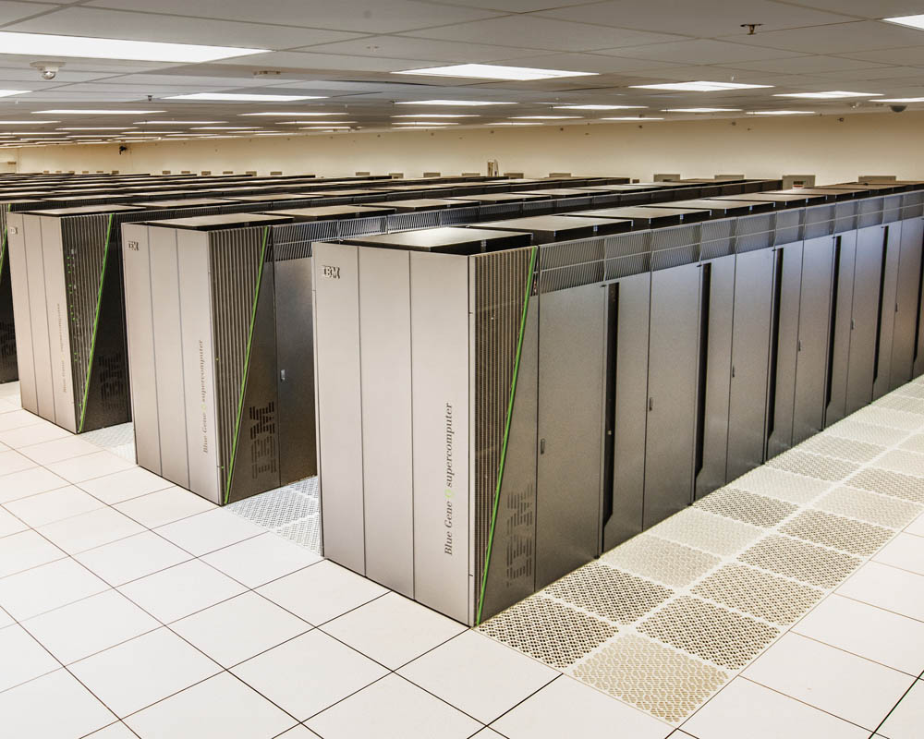
Sequoia
16.32 PFLOPS
98,304 nodes with 1,572,864 million cores 1.6 petabytes of memory
7.9 MWatts total power

Slide 92
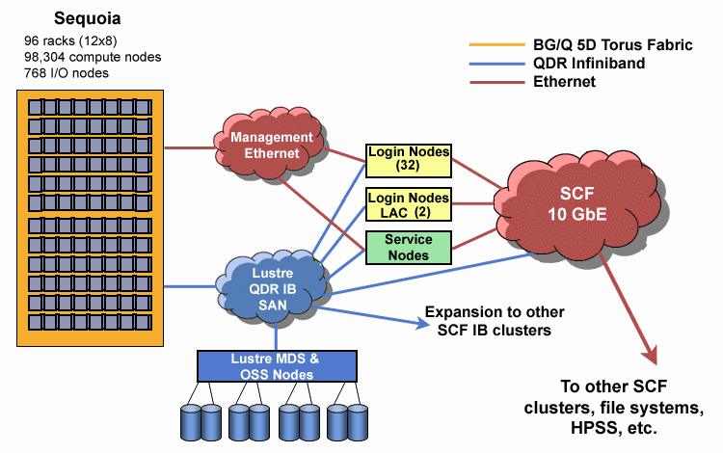
Source: LLNL

Slide 93
Questions?
Source: Wikipedia (Japanese rock garden)

